Slide 1


Introduction to Energy Consumption Prediction
Energy consumption prediction is a crucial task for efficient resource planning and management. This presentation will explore machine learning techniques, specifically the K-Nearest Neighbors (KNN) algorithm and Artificial Neural Network (ANN), to forecast energy usage patterns and identify driving factors.
Done By:
K. Shyam Sai Manohar

Slide 2

Importance of Accurate Prediction
1
Resource Allocation
2
Cost Optimization
Accurate energy consumption prediction enables optimal allocation of resources, such as electricity, fuel, and infrastructure, to meet demand efficiently.
Precise forecasting can help reduce energy costs by identifying opportunities for conservation and strategic procurement.
3
Sustainability
Accurate prediction supports the transition to renewable energy sources and the implementation of energy-efficient technologies.

Slide 3
Overview of Machine Learning Techniques
K-Nearest Neighbors (KNN)
Artificial Neural Network (ANN)
Comparative Advantages
KNN is a non-parametric, instance-based learning algorithm that predicts energy consumption by analyzing the similarity of historical data.
ANN is a powerful, biologically-inspired machine learning model that can capture complex, non-linear relationships in energy consumption data.
KNN is intuitive and easy to implement, while ANN excels at handling large, complex datasets and identifying hidden patterns.

Slide 4
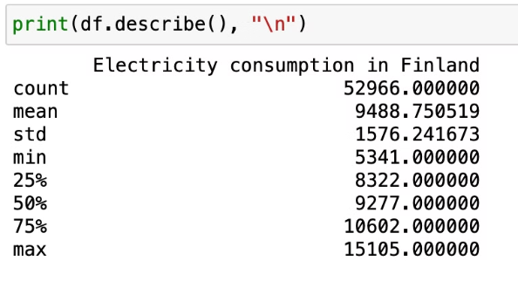
DATASET DESCRIPTION
Our dataset consists of 57000 records with 3 feature (year, month, day).

Slide 5
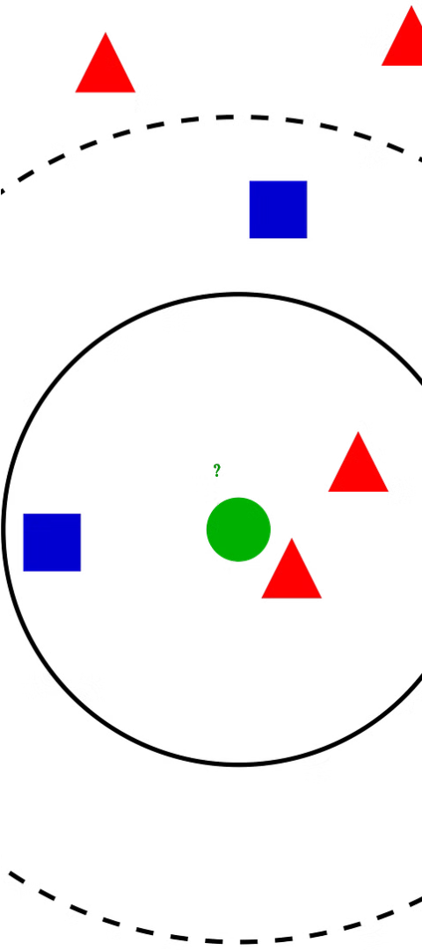
K-Nearest Neighbors (KNN) Algorithm
1
Data Representation
KNN represents energy consumption data as points in a multi-dimensional feature space.
2
Nearest Neighbor Search
The algorithm identifies the K closest neighbors to a new data point to predict its energy consumption.
3
Prediction
The energy consumption of the new data point is estimated based on the average or weighted average of its K nearest neighbors.

Slide 6
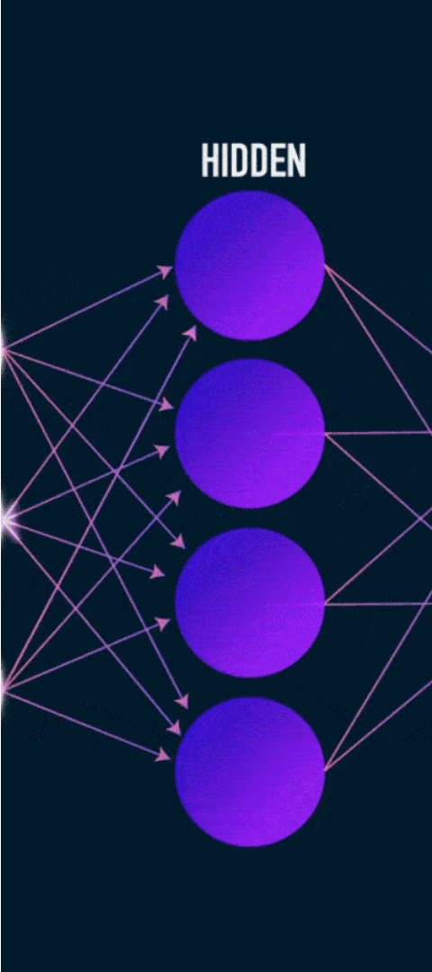



Artificial Neural Network (ANN) Algorithm
Input Layer
The input layer receives the energy consumption data and associated features.
Hidden Layers
The hidden layers learn complex, non-linear relationships within the data through a series of weighted connections.
Output Layer
The output layer produces the predicted energy consumption based on the learned patterns.

Slide 7
Comparison of KNN and ANN Performance
Accuracy
Computational Complexity
Interpretability
In our case, since the data has a linear pattern, KNN outperforms ANN in terms of prediction accuracy.
KNN is more intuitive and easier to interpret than ANN, which can be advantageous when dealing with linear data.
KNN is simpler and faster to implement compared to ANN. This makes it a suitable choice for linear data.

Slide 8
Data Preprocessing and Feature Engineering
1
Data Cleaning
2
Feature Selection
Handling missing values, outliers, and irrelevant features to ensure data quality.
Identifying the most influential factors, such as weather, occupancy, and historical consumption patterns.
3
Feature Engineering
4
Normalization
Creating new features from the raw data to enhance the model's predictive power.
Scaling the features to a common range to improve the model's convergence and performance.

Slide 9
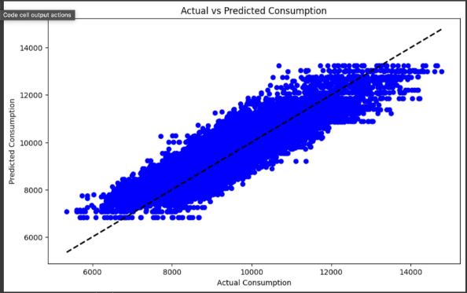
KNN PLOT
In our model the accuracy by using KNN is 94%
KNN outperform ANN because the dataset is linear

Slide 10
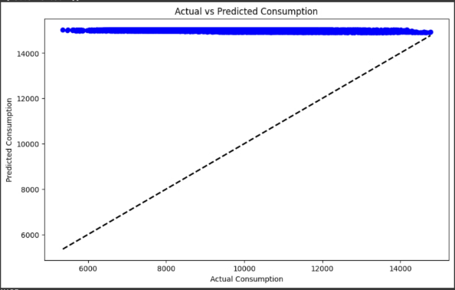
ANN PLOT
In our model the accuracy by using ANN is 64%. the relationships between the input features and the target variable can be adequately described by linear functions. In this scenario, it's reasonable to expect that simpler models like linear regression might perform as well as, if not better than, more complex models such as Artificial Neural Networks (ANNs).

Slide 11
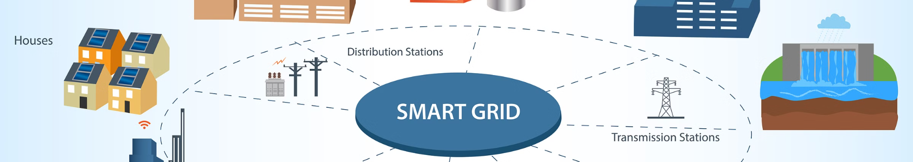
Conclusion and Future Considerations
Conclusion
Future Considerations
Ongoing Research
Accurate energy consumption prediction using machine learning techniques, such as KNN and ANN, can significantly improve resource planning, cost optimization, and sustainability efforts.
Integrating additional data sources, such as weather patterns and socioeconomic factors, can further enhance the predictive accuracy of these models.
Exploring ensemble methods and deep learning architectures can lead to even more robust and reliable energy consumption forecasting models.

Slide 12
Thank You

